Slide 1



Price Optimization
In Retail Industry
Develop an AI system that dynamically adjusts product pricing based on demand, competition, and other market factors to maximize profitability.
Group C

Slide 2
Team Member
1
2
3
4
5
Abhishek Pandey
Govind Ram Gupta Belde
Ram Krishna Dhakal
Bibek Khadka
Kamalpreet Kaur

Slide 3
TABLE OF CONTENTS
01
02
03
04
05
ABOUT THE PROJECT
MAJOR REQUIREMENTS
PROJECT GOALS
HIGH LEVEL ARCHITECTURE
PROJECT STAGES

Slide 4


01
ABOUT THE PROJECT
Why Price Optimization and How AI ?

Slide 5
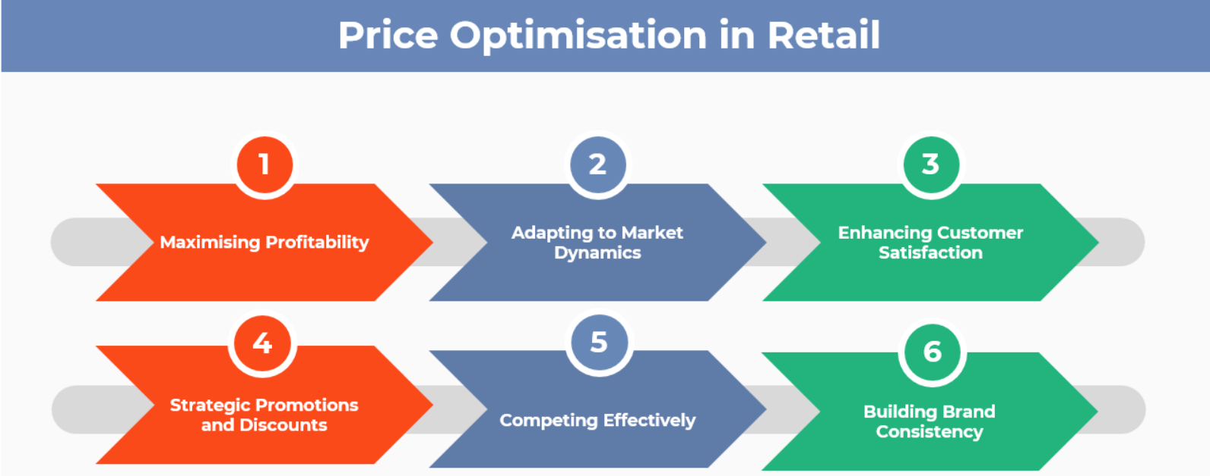
Why Price Optimization ?
Reference Link

Slide 6

How AI ?
Real-Time Data Processing: AI analyzes vast data sources like sales trends, competitor prices, and market conditions in real time, enabling smarter pricing decisions.
Dynamic Pricing: AI facilitates dynamic pricing by adjusting prices in real time based on market changes, competition, and demand fluctuations.
Personalized Pricing: AI personalizes prices for individual customers based on their behavior, boosting loyalty and conversion rates.
Comprehensive Pricing Models: AI creates advanced pricing models by factoring in production costs, seasonality, inventory, and competitor pricing for optimal profitability.

Slide 7
MAJOR REQUIREMENTS
Preprocessing
Identifying the data source
Making the data ready for model building
Scraping historic data related to retail industry
Model building and Fine-Tuning
UI and Deployment
Finalizing the UI.
Identifying the platform to deploy
Choosing the relevant model and Fine-tuning.

Slide 8
PROJECT GOALS
Creating a User friendly dashboard for companies to track the pricing
GOAL 1
Making a best fit model which can withstand different scenarios
GOAL 2
Creating the best product for price optimization
GOAL 3

Slide 9
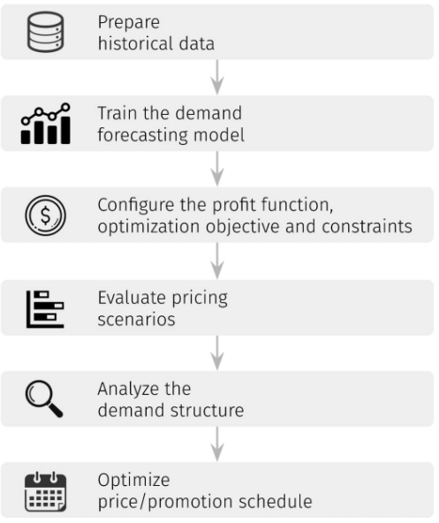
HIGH LEVEL ARCHITECTURE
Reference link

Slide 10
PROJECT STAGES
PROBLEM DEFINITION AND REQUIREMENT GATHERING
PRE-PROCESSING AND FINE-TUNING MODEL
UI AND DEPLOYMENT

Slide 11
TIMELINE
Pre-Processing and Feature Engineering
UI and Deployment
Mid Term
Final
CASE STUDY 1
CASE STUDY 2
Data Source Identification
Model building and Fine Tuning

Slide 12
THANK YOU
Git Hub: https://github.com/abhi526691/Price-Optimization-For-Retail

